Slide 1
Introduction to Databases
Paul kisambira
Email: pkisambira@ucu.ac.ug

Slide 2
What is a database
A database is any organized collection of data. Some examples of databases you may encounter in your daily life are:
a telephone book
T.V. Guide
airline reservation system
motor vehicle registration records
papers in your filing cabinet
files on your computer hard drive.

Slide 3
Data vs. information: What is the difference?
What is data?
Data can be defined in many ways. Information science defines data as unprocessed information.
What is information?
Information is data that have been organized and communicated in a coherent and meaningful manner.
Data is converted into information, and information is converted into knowledge.
Knowledge; information evaluated and organized so that it can be used purposefully.

Slide 4
Why do we need a database?
Keep records of our:
Clients
Staff
Volunteers
To keep a record of activities and interventions;
Keep sales records;
Develop reports;
Perform research
Longitudinal tracking

Slide 5
What is the ultimate purpose of a database management system?
Is to transform
Data
Information
Knowledge
Action

Slide 6
More about database definition
What is a database?
Quite simply, it’s an organized collection of data. A database management system (DBMS) such as Access, FileMaker, Open office base, Oracle or SQL Server which provides you with the software tools you need to organize that data in a flexible manner. It includes tools to add, modify or delete data from the database, ask questions (or queries) about the data stored in the database and produce reports summarizing selected contents.

Slide 7
Foundation Data Concepts
Abstract Concepts
Entity – person, place, object or event – stored as a record or a table row
Attribute – characteristic of an entity – stored as field or table column

Slide 8
Foundation Data Concepts
Database Concepts
Database – a collection of related tables
Tables – a collection of related records – collection of related entities
Record – collection of fields (table row) –represents an entity
Field – collection of characters (table column) – represents an attribute
Character – single alphabetic, numeric or other symbol
Large
Small

Slide 9
Fields
Characters “B R E I M E R” form a field
A field is an attribute of an entity
Last Name
Breimer

Slide 10
Records
A bunch of fields form a record
A record is an entity
First Name
Eric
Last Name
Breimer
Sex
Yes
Weight
263

Slide 11
Tables
A bunch of records forms a table
A table is a group of related entities
First Name | Last Name | Sex | Age
Eric | Breimer | M | 30
Jeff | Albert | M | 22
Jackie | Pizzo | F | 21

Slide 12
0
Databases
A bunch of tables form a database
A database can represent a single business or an entire market
Order Table
Customer Table
Product Table

Slide 13
0
Databases
But, databases are not just a bunch of tables
A database also includes relationships between the different tables
Orders
OID | CID | PID | Quantity
001 | 508 | 199 | 500,000
002 | 508 | 201 | 2
003 | 510 | 201 | 1
Customers
CID | FName | LName | Address
508 | Eric | Breimer | ...
509 | Andrew | Zych | ...
510 | Greg | Smith | ...
Products
PID | Description | Cost
199 | Viagra | $45.99
200 | Tooth Paste | $2.58
201 | Hair Gel | $5.99

Slide 14
Database Concepts
Primary key – An attribute that is selected to uniquely identifies each record within a relation.
A primary key value must be unique and cannot be null(left empty on data entry).
Foreign key – An attribute within one relation that matches another attribute of another or same relation.
A foreign key value must match the primary/unique key value of some row in its parent relation
Relational Database Concepts
1.1
Notes:
1

Slide 15
0
Relationships & Queries in Databases

Slide 16
Types of Relationships
One to One
Examples?
Analysis Technique
Consider ThingA and ThingB
Can ThingA be related to more than one ThingB?
Can ThingB be related to more than one ThingA?
If the two answers are NO, then it is a one to one relationship.
ThingA
ThingB
Relationship
Man
Woman
Married

Slide 17
Types of Relationships
Student
One to Many
Examples?
Analysis Technique
Consider ThingA and ThingB
Can ThingA be related to more than one ThingB?
Can ThingB be related to more than one ThingA?
If only one answer is yes, then you have a one to many relationship
Faculty
Student
Student
Advises
Get Advisement

Slide 18
Types of Relationships
student takes course
Student
Course
Student
Many to Many
Examples?
Analysis Technique
Consider ThingA and ThingB
Can ThingA be related to more than one ThingB?
Can ThingB be related to more than one ThingA?
If the answers are yes and yes, then the relationship is many to many.
Course
Student
Student
course has a student

Slide 19
How to Model Relationships
Orders
OID | CID | PID | Quantity
001 | 508 | 199 | 500,000
002 | 508 | 201 | 2
003 | 510 | 201 | 1
Customers
CID | FName | LName | Address
508 | Eric | Breimer | ...
509 | Andrew | Zych | ...
510 | Greg | Smith | ...
Products
PID | Description | Cost
199 | Viagra | $45.99
200 | Tooth Paste | $2.58
201 | Hair Gel | $5.99

Slide 20
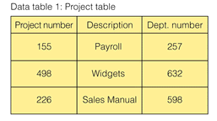
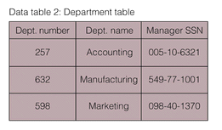
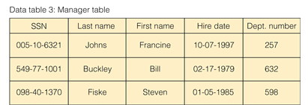
Find the name and hire date of the manager working on the sales manual project

Slide 21
Traditional File Processing Sucks
File Processing:
Data is organized, stored, and processed in independent files of data records
Vs
Database Management Approach
Consolidates data records into one CENTRAL database that can be accessed by many different application programs.

Slide 22
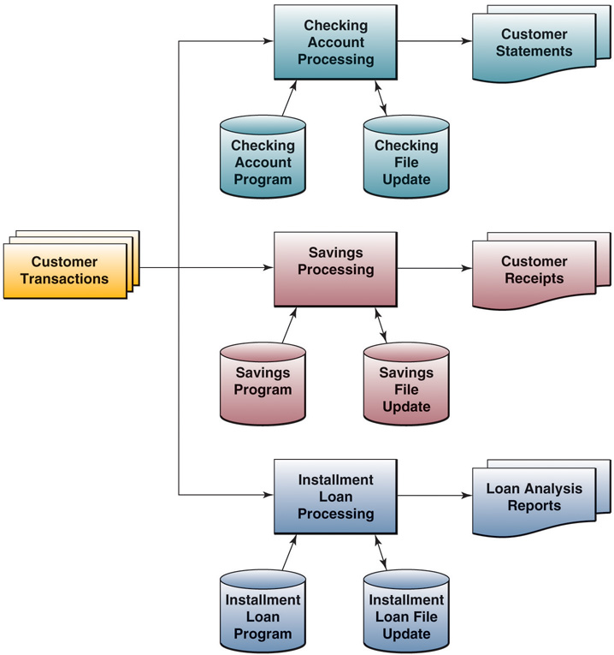
Problems of File Processing
Data Redundancy –
duplicate data requires update to many files
Lack of Integration –
data stored in separate files hard to combine data
Data Dependence –
changing the file format requires changing the program…

Slide 23
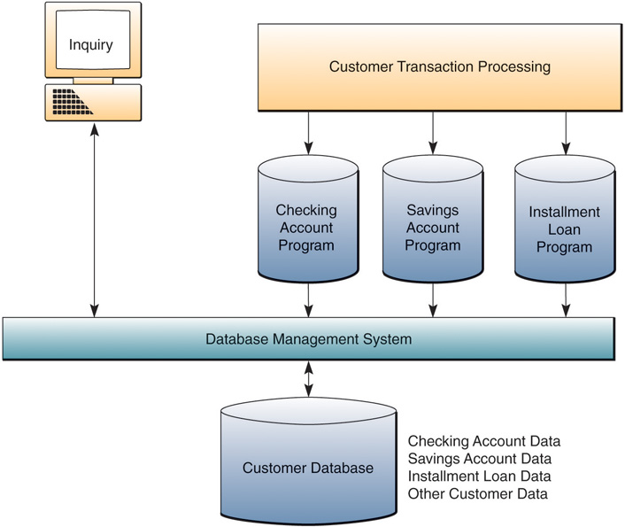

Slide 24
Database Management Software (DBMS)
Definition:
Software that controls the creation, maintenance, and use of databases

